Slide 1
Basic Discrete Structure : Set
Lecture 4
Notes:
‹#›

Slide 2
Basic Discrete Structure
Discrete math =
– study of the discrete structures used to represent discrete objects
Many discrete structures are built using sets
– Sets = collection of objects
Examples of discrete structures built with the help of sets:
• Combinations
• Relations
• Graphs
Notes:
‹#›

Slide 3
Set
Definition:
A set is a (unordered) collection of objects.
These objects are sometimes called elements or members of the set.
• Examples:
– Vowels in the English alphabet
V = { a, e, i, o, u }
– First seven prime numbers.
X = { 2, 3, 5, 7, 11, 13, 17 }
Notes:
‹#›

Slide 4
Representing Set
Representing a set by:
1) Listing (enumerating) the members of the set.
2) Definition by property, using the set builder notation
{x| x has property P}.
Example:
• Even integers between 50 and 63.
1) E = {50, 52, 54, 56, 58, 60, 62}
2) E = {x| 50 <= x < 63, x is an even integer}
If enumeration of the members is hard we often use ellipses.
Example: a set of integers between 1 and 100
• A= {1,2,3 …, 100}
Notes:
‹#›

Slide 5
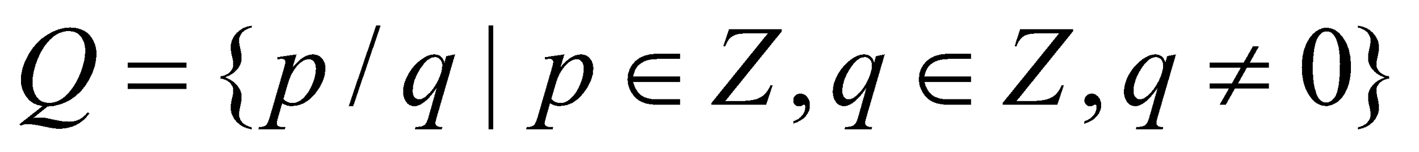
Important set in discrete math
Natural numbers:
– N = {0,1,2,3, …}
• Integers
– Z = {…, -2,-1,0,1,2, …}
• Positive integers
– Z+ = {1,2, 3.…}
• Rational numbers
–
• Real numbers
– R
Notes:
‹#›

Slide 6
Equality of Set
Definition: Two sets are equal if and only if they have the same elements.
Example:
• {1,2,3} = {3,1,2} = {1,2,1,3,2}
Note: Duplicates don't contribute anything new to a set, so remove them. The order of the elements in a set doesn't contribute anything new.
Example: Are {1,2,3,4} and {1,2,2,4} equal?
No!
Notes:
‹#›

Slide 7
Universal set
Special sets:
– The universal set is denoted by U: the set of all objects
under the consideration.
– The empty set is denoted as Ø or { }.
Notes:
‹#›

Slide 8
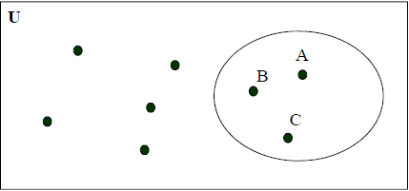
Venn Diagram
A set can be visualized using Venn Diagrams:
– V={ A, B, C }
Notes:
‹#›

Slide 9

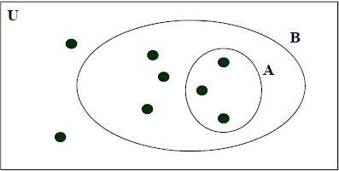
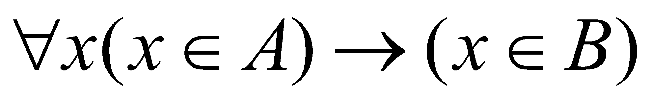
A subset
Definition: A set A is said to be a subset of B if and only if every element of A is also an element of B. We use to indicate A is a subset of B.
Alternate way to define A is a subset of B:
Notes:
‹#›

Slide 10
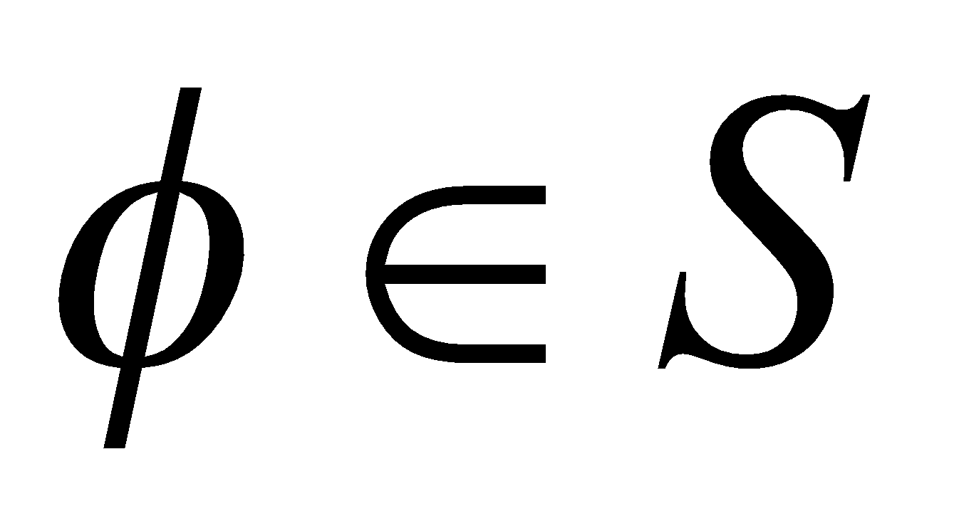
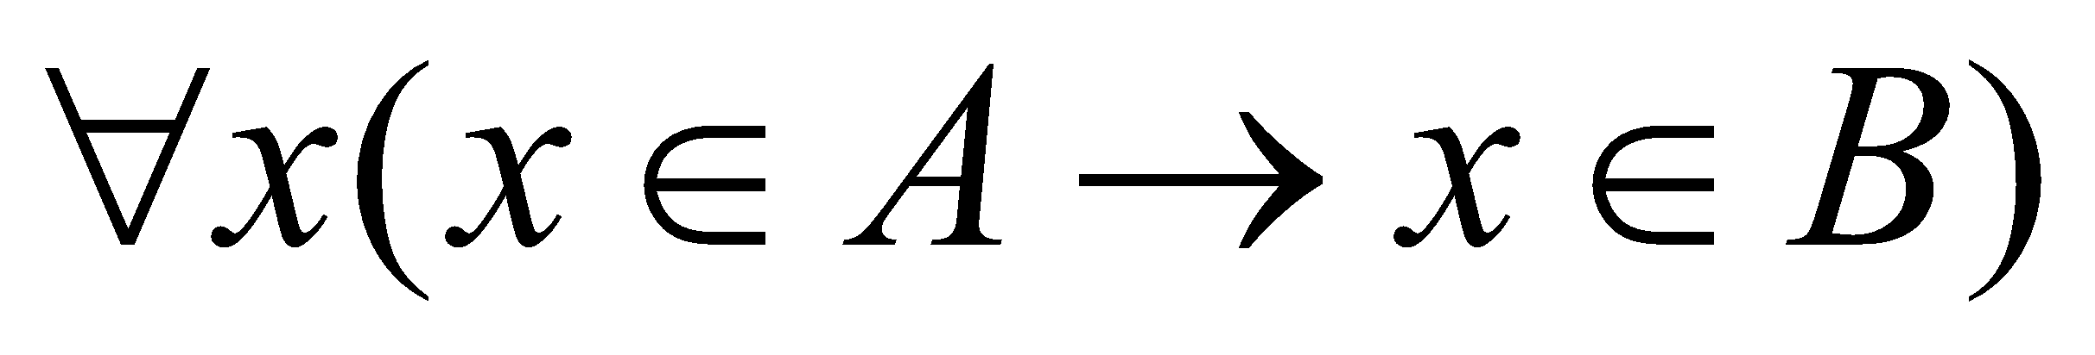
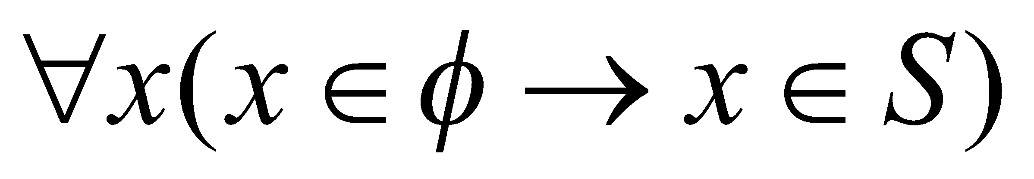
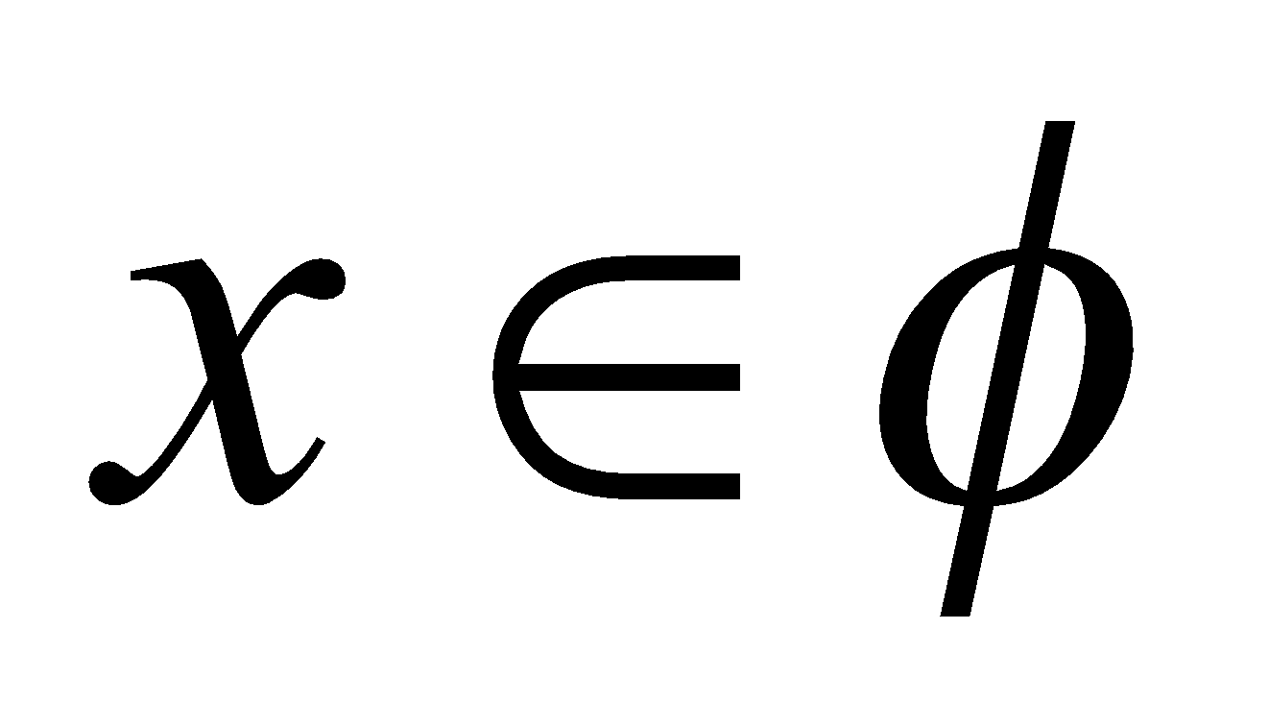
Empty set/subset property
Theorem :
• Empty set is a subset of any set.
Proof:
Recall the definition of a subset: all elements of a set A must be also elements of B:
We must show the following implication holds for any
Since the empty set does not contain any element, is always False
Then the implication is always True. (F → T/F =T)
End of proof
Notes:
‹#›

Slide 11
Venn diagram of Empty set
Theorem :
• Empty set is a subset of any set.
U
A
Ø
Notes:
‹#›

Slide 12
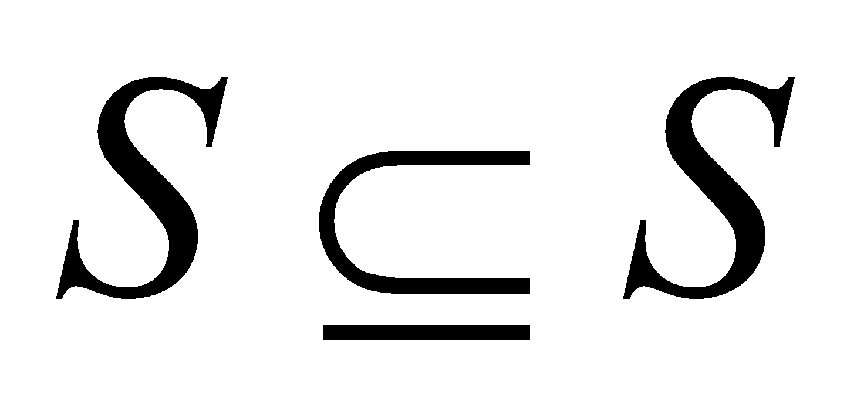
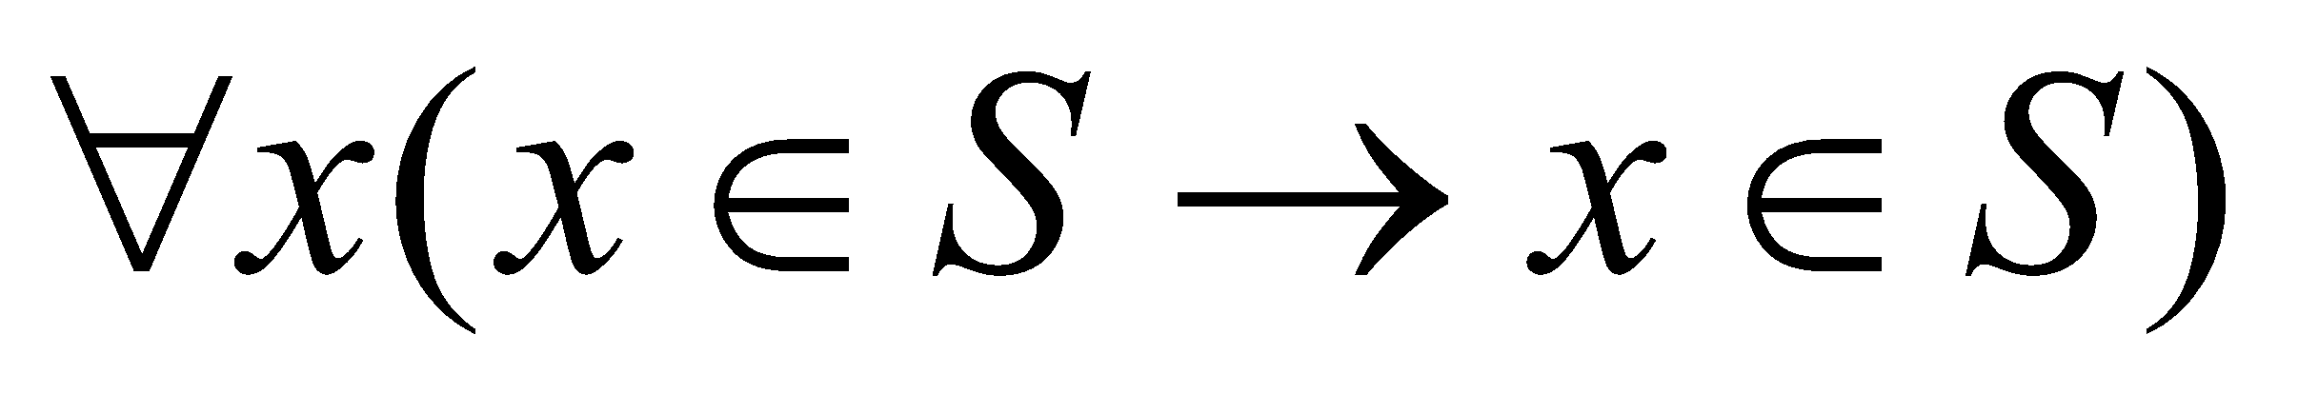
Subset property
Theorem:
• Any set S is a subset of itself
Proof:
• the definition of a subset says: all elements of a set A must be also elements of B:
• Applying this to S we get:
• which is trivially True
• End of proof
Note on equivalence:
• Two sets are equal if each is a subset of the other set.
Notes:
‹#›

Slide 13
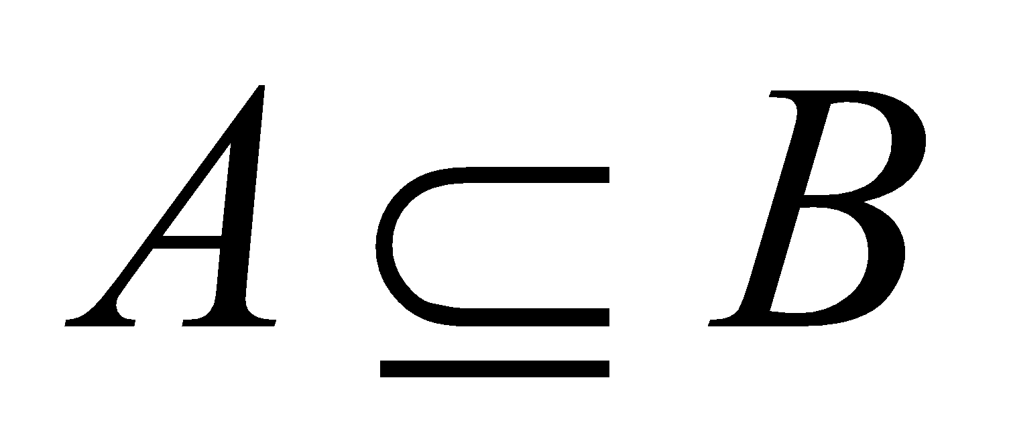
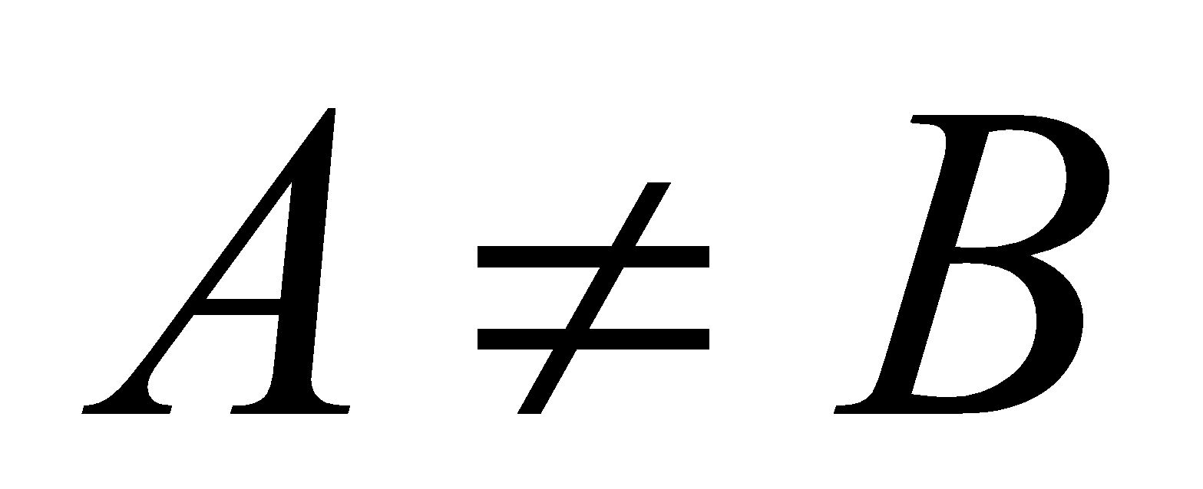

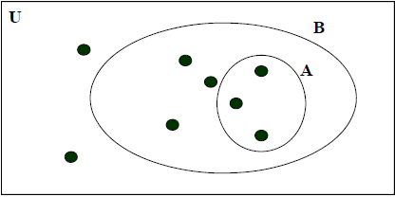
A proper Subset
Definition:
A set A is said to be a proper subset of B if and only if
and . We denote that A is a proper subset of B with the notation .
Example: A={1,2,3} B ={1,2,3,4,5}
Is: ?
Notes:
‹#›

Slide 14
A proper Subset
Definition:
A set A is said to be a proper subset of B if and only if
and . We denote that A is a proper subset of B with the notation .
Example: A={1,2,3} B ={1,2,3,4,5}
Is: ? Yes.
Notes:
‹#›

Slide 15
Cardinality
Definition: Let S be a set. If there are exactly n distinct elements in S, where n is a nonnegative integer, we say S is a finite set and that n is the cardinality of S. The cardinality of S is denoted by | S |.
Examples:
• V={1 2 3 4 5}
| V | = 5
• A={1,2,3,4, …, 20}
|A| =20
• | Ø | = 0
Notes:
‹#›

Slide 16
Infinite set
Definition: A set is infinite if it is not finite.
Examples:
• The set of natural numbers is an infinite set.
• N = {1, 2, 3, ... }
• The set of real numbers is an infinite set.
Notes:
‹#›

Slide 17
Power set
Definition: Given a set S, the power set of S is the set of all subsets of S. The power set is denoted by P(S).
Example
What is the power set of Ø ? P(Ø ) = {Ø}
• What is the cardinality of P(Ø) ? | P(Ø) | = 1.
Assume {1,2,3}
• P({1,2,3}) = {Ø, {1}, {2}, {3}, {1,2}, {1,3}, {2,3}, {1,2,3} }
• |P({1,2,3} | = 8
If S is a set with |S| = n then | P(S) | = ? 2^{n}
Notes:
‹#›

Slide 18
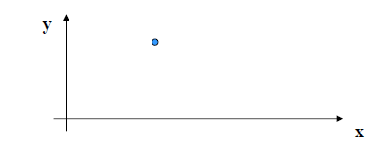
N-tuple
Sets are used to represent unordered collections.
• Ordered-n tuples are used to represent an ordered collection.
Definition: An ordered n-tuple (x1, x2, ..., xN) is the ordered
collection that has x1 as its first element, x2 as its second
element, ..., and xN as its N-th element, N ˃= 2.
Example: Coordinates of a point in the 2-D plane (12, 16)
Notes:
‹#›

Slide 19
Cartesian Product
Definition: Let S and T be sets. The Cartesian product of S and T, denoted by S x T, is the set of all ordered pairs (s,t), where s ϵ S and t ϵ T. Hence,
• S x T = { (s,t) | s ϵ S ˄ t ϵ T}.
Examples:
• S = {1,2} and T = {a,b,c}
• S x T = { (1,a), (1,b), (1,c), (2,a), (2,b), (2,c) }
• T x S = { (a,1), (a, 2), (b,1), (b,2), (c,1), (c,2) }
• Note: S x T ≠ T x S !!!!
Notes:
‹#›

Slide 20
Cardinality of a Cartesian Product
• |S x T| = |S| * |T|.
Example:
• A= {John, Peter, Mike}
• B ={Jane, Ann, Laura}
• A x B= {(John, Jane),(John, Ann) , (John, Laura), (Peter, Jane),
(Peter, Ann) , (Peter, Laura) , (Mike, Jane) , (Mike, Ann) ,
(Mike, Laura)}
• |A x B| = 9
• |A|=3, |B|=3 → |A| |B|= 9
Definition: A subset of the Cartesian product A x B is called a relation from the set A to the set B.
Notes:
‹#›

Slide 21
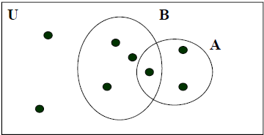
Set Operation
Definition: Let A and B be sets. The union of A and B, denoted by A U B, is the set that contains those elements that are in both A andB.
• Alternate: A U B = { x | x ϵ A V x ϵ B }.
Example:
• A = {1,2,3,6} and B = { 2,4,6,9}
• A U B = { 1,2,3,4,6,9 }
Notes:
‹#›

Slide 22
Set Operation
Definition: Let A and B be sets. The intersection of A and B, denoted by A ∩ B, is the set that contains those elements that are in both A andB.
• Alternate: A ∩ B = { x | x ϵ A ˄ x ϵ B }.
Example:
• A = {1,2,3} and B = { 2,4,6,9}
• A ∩ B = { 2 }
Notes:
‹#›

Slide 23
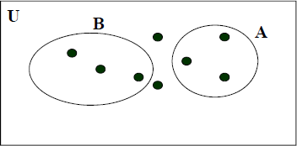
Disjoin Set
Definition: Two sets are called disjoint if their intersection is empty.
• Alternate: A and B are disjoint if and only if A ∩ B = Ø.
Example:
• A={1,2,3,6} B={4,7,8} Are these disjoint?
• Yes.
• A ∩ B = Ø
Notes:
‹#›

Slide 24
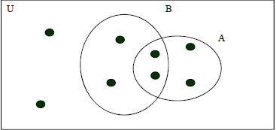
Cardinality of set union
Cardinality of the set union.
• |AU B| = |A| + |B| - |A ∩ B|
Why this formula? Correct for an over-count.
Notes:
‹#›

Slide 25
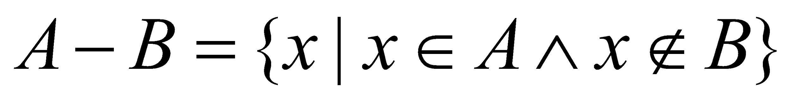
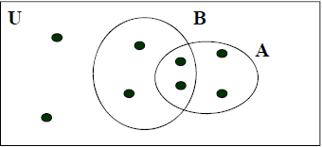
Set Difference
Definition: Let A and B be sets. The difference of A and B,
denoted by A - B, is the set containing those elements that are in but not in B. The difference of A and B is also called the complement of B with respect to A.
• Alternate:
Example: A= {1,2,3,5,7} B = {1,5,6,8}
• A - B ={2,3,7}
Notes:
‹#›

Slide 26
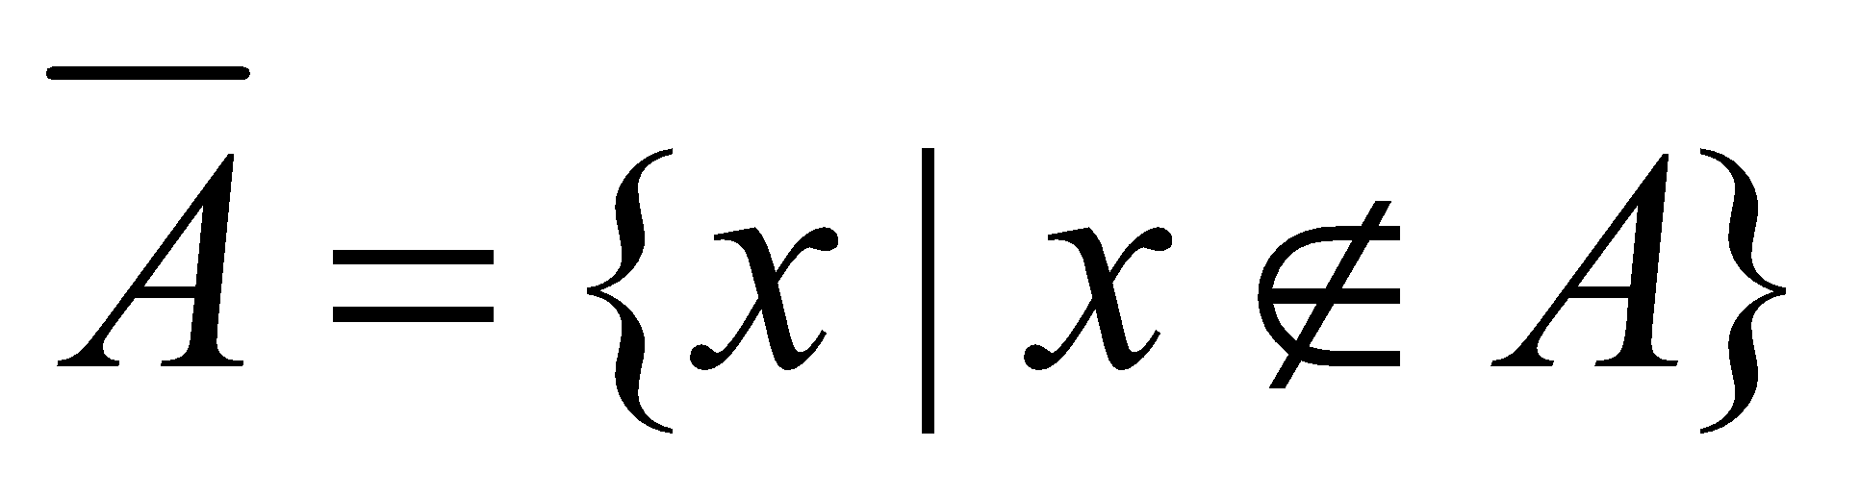
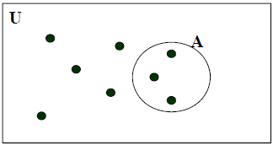
Complement of a Set
Definition: Let U be the universal set: the set of all objects under the consideration.
Definition: The complement of the set A, denoted by Ã, is the complement of A with respect to U.
• Alternate: Alternate:
Example: U={1,2,3,4,5,6,7,8} A ={1,3,5}
• Ã={2,4,6,7,8}
Notes:
‹#›

Slide 27
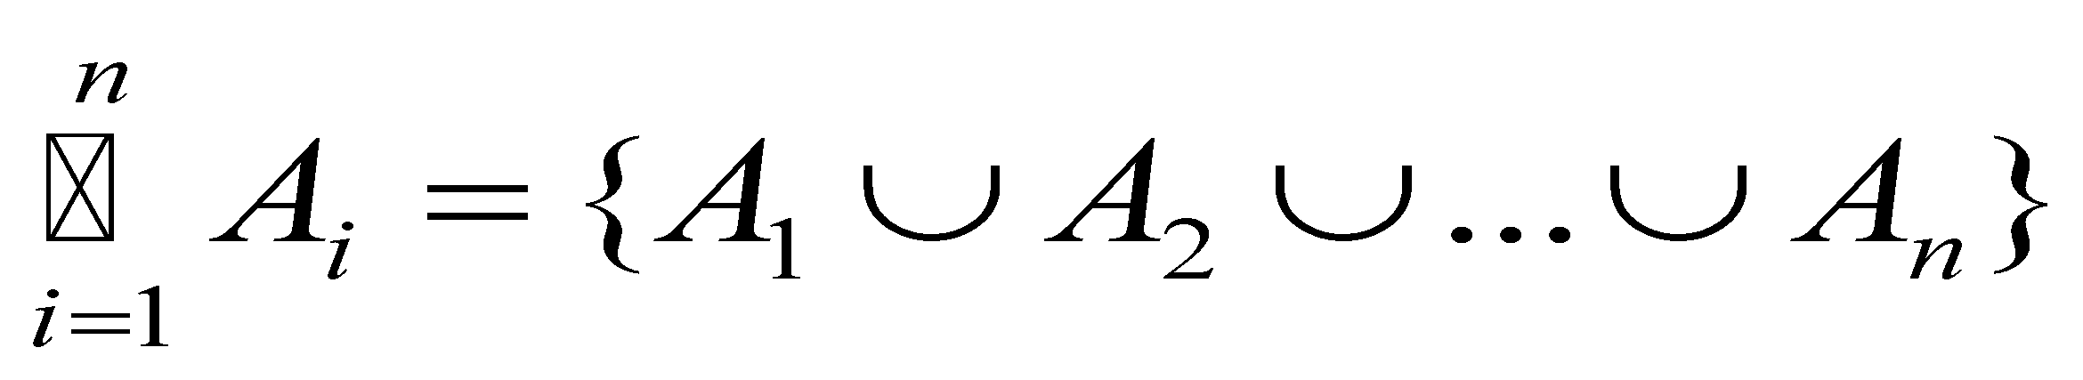
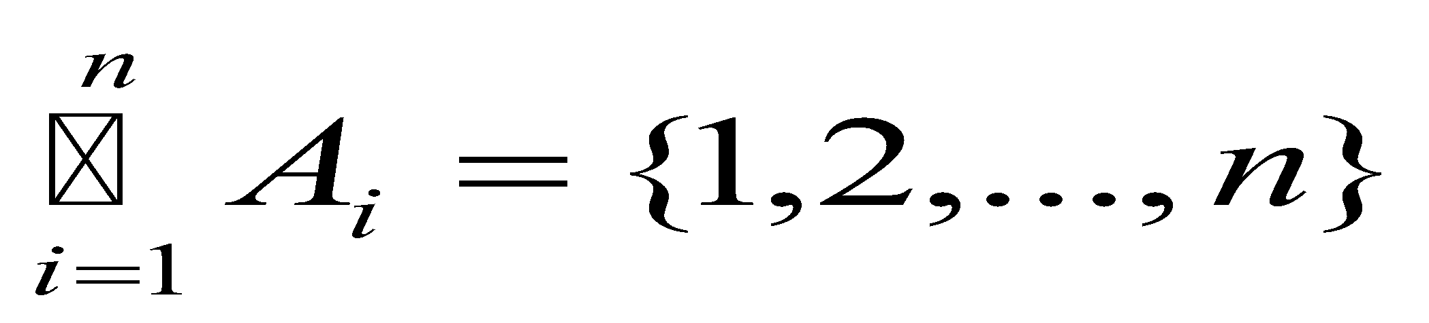
Generalized union
Definition: The union of a collection of sets is the set that
contains those elements that are members of at least one set
in the collection.
Example:
• Let A_{i}= {1,2,...,i} i =1,2,...,n
A₁ = {1}
A₂= {1,2}
A₃= {1,2,3}
…………..
…………..
A_{n} {1,2,3,4,...,n}
Notes:
‹#›

Slide 28
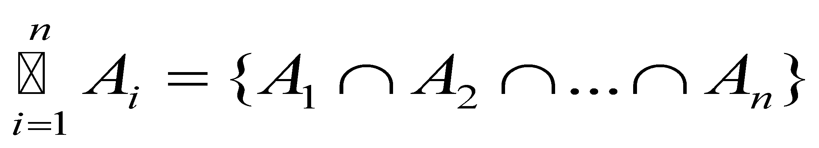
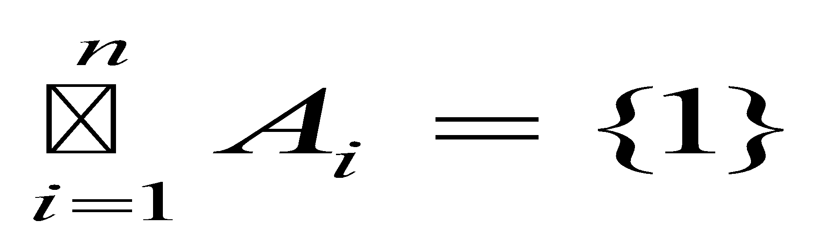
Generalized intersection
Definition: The intersection of a collection of sets is the set that contains those elements that are members of all sets in the collection.
Example:
• Let A_{i}= {1,2,...,i} i =1,2,...,n
A₁ = {1}
A₂= {1,2}
A₃= {1,2,3}
…………..
…………..
A_{n} {1,2,3,4,...,n}
Notes:
‹#›

Slide 29
Computer representation of set
How to represent sets in the computer?
• One solution: Data structures like a list
• A better solution: Assign a bit in a bit string to each element in the universal set and set the bit to 1 if the element is present otherwise use 0
Example:
All possible elements: U={1 2 3 4 5}
• Assume A={2,5}
– Computer representation: A = 01001
• Assume B={1,5}
– Computer representation: B = 10001
Notes:
‹#›

Slide 30
Computer representation of set
Example:
• A = 01001
• B = 10001
• The union is modeled with a bitwise or
• A U B = 11001
• The intersection is modeled with a bitwise and
• A ∩ B = 00001
• The complement is modeled with a bitwise negation
• Ã =10110
Notes:
‹#›

Slide 31
Basic Discrete Structure : Set and Function
Notes:
‹#›

Slide 32
Quiz Problem 1
1. | Suppose the following two statements are true. I love Dad or I love Mum If I love Dad then I love Mum Does it necessarily follow that I love Dad? Does it necessarily follow that I love Mum? Use propositional logic to answer the questions.
P (I love dad) | Q (I love mum) | P˅Q | P→Q
F | F | F | T
F | T | T | T
T | F | T | F
T | T | T | T

Slide 33
Quiz Problem 1
1. | Suppose the following two statements are true. I love Dad or I love Mum If I love Dad then I love Mum Does it necessarily follow that I love Dad? Does it necessarily follow that I love Mum? Use propositional logic to answer the questions.
P (I love dad) | Q (I love mum) | P˅Q | P→Q
F | F | F | T
F | T | T | T
T | F | T | F
T | T | T | T

Slide 34
Quiz Problem 2
2. | Consider the following specification with two predicate symbols p₁≡(<), p₂≡(=) two function symbols f₁≡(+), f₂≡(×) two constant symbols c₁ ≡(0), c₂≡(1) Let domain of discourse be <Z₊ ∪ {0}> where Z₊={1,2,….} What are the truth values of the following statements? ∀x p₁(c₁,x) ∀x∀y∃z (p₁(x,z) ∧ p₁(z,y)) ∃x∀yp₁(x,y) ∀x∀y p₂(f₂(f₁(x,c₂),y), f₁(f₂(x,y),y))
i. | False | 0<x

Slide 35
Quiz Problem 2
2. | Consider the following specification with two predicate symbols p₁≡(<), p₂≡(=) two function symbols f₁≡(+), f₂≡(×) two constant symbols c₁ ≡(0), c₂≡(1) Let domain of discourse be <Z₊ ∪ {0}> where Z₊={1,2,….} What are the truth values of the following statements? ∀x p₁(c₁,x) ∀x∀y∃z (p₁(x,z) ∧ p₁(z,y)) ∃x∀yp₁(x,y) ∀x∀y p₂(f₂(f₁(x,c₂),y), f₁(f₂(x,y),y))
i. | False | 0<x
ii. | False | x< z ∧ z<y

Slide 36
Quiz Problem 2
2. | Consider the following specification with two predicate symbols p₁≡(<), p₂≡(=) two function symbols f₁≡(+), f₂≡(×) two constant symbols c₁ ≡(0), c₂≡(1) Let domain of discourse be <Z₊ ∪ {0}> where Z₊={1,2,….} What are the truth values of the following statements? ∀x p₁(c₁,x) ∀x∀y∃z (p₁(x,z) ∧ p₁(z,y)) ∃x∀yp₁(x,y) ∀x∀y p₂(f₂(f₁(x,c₂),y), f₁(f₂(x,y),y))
i. | False | 0<x
ii. | False | x< z ∧ z<y
iii. | False | x<y

Slide 37
Quiz Problem 2
2. | Consider the following specification with two predicate symbols p₁≡(<), p₂≡(=) two function symbols f₁≡(+), f₂≡(×) two constant symbols c₁ ≡(0), c₂≡(1) Let domain of discourse be <Z₊ ∪ {0}> where Z₊={1,2,….} What are the truth values of the following statements? ∀x p₁(c₁,x) ∀x∀y∃z (p₁(x,z) ∧ p₁(z,y)) ∃x∀yp₁(x,y) ∀x∀y p₂(f₂(f₁(x,c₂),y), f₁(f₂(x,y),y))
i. | False | 0<x
ii. | False | x< z ∧ z<y
iii. | False | x<y
iv | True | xy +y = xy+y

Slide 38
Quiz Problem 3
3. | Let A be the set of English words that contains x, and B be the set of English words that contain the letter q. Express each of these sets as a combination of A and B. The set of English words that do not contain the letter x. The set of English words that contain an x but not a q. The set of English words that do not contain either an x or a q.
i. | U – A

Slide 39
Quiz Problem 3
3. | Let A be the set of English words that contains x, and B be the set of English words that contain the letter q. Express each of these sets as a combination of A and B. The set of English words that do not contain the letter x. The set of English words that contain an x but not a q. The set of English words that do not contain either an x or a q.
i. | U – A
ii. | A –B

Slide 40
Quiz Problem 3
3. | Let A be the set of English words that contains x, and B be the set of English words that contain the letter q. Express each of these sets as a combination of A and B. The set of English words that do not contain the letter x. The set of English words that contain an x but not a q. The set of English words that do not contain either an x or a q.
i. | U – A
ii. | A –B
iii. | U – (A ∩ B)

Slide 41
Quiz Problem 4
4. | Let A = {a, b, c}, B = {x, y} and C= {0, 1}. Find C × B × A.
C×B | {{0,x}{0,y},{1,x}{1,y}}

Slide 42
Quiz Problem 4
4. | Let A = {a, b, c}, B = {x, y} and C= {0, 1}. Find C × B × A.
C×B | {{0,x}{0,y},{1,x}{1,y}}
C × B × A | {{0,x,a}, {0,x,b}, {0,x,c},{0,y,a}, {0,y,b}, {0,y,c},{1,x,a}, {1,x,b}, {1,x,c},{1,y,a}, {1,y,b}, {1,y,c}}

Slide 43
Quiz Problem 5
5. | Let f be the function from R to R defined by y=f(m,n)=2m-n. Write a method signature in C with appropriate return type and parameter list that could be used to realize the function.
double f(double m, double n);

Slide 44

Definitions and notation
Check these:
Is {x} ⊆ {x}?
Is {x} ∈ {x,{x}}?
Yes
Is {x} ⊆ {x,{x}}?
Yes
Is {x} ∈ {x}?
No
Notes:
‹#›

Slide 45
Operators
The symmetric difference, A ⊕ B, is:
A ⊕ B = { x : (x ∈ A ∧ x ∉ B) v (x ∈ B ∧ x ∉ A)}
like “exclusive or”
= (A - B) U (B - A)
U
A
B
Notes:
‹#›

Slide 46
Operators
Proof: { x : (x ∈ A ∧ x ∉ B) v (x ∈ B ∧ x ∉ A)}
= (A - B) U (B - A)
A ⊕ B = { x : (x ∈ A ∧ x ∉ B) v (x ∈ B ∧ x ∉ A)}
= { x : (x ∈ A - B) v (x ∈ B - A)}
= { x : x ∈ ((A - B) U (B - A))}
= (A - B) U (B - A)
Notes:
‹#›

Slide 47
Famous Identities
Identity
Domination
Idempotent
A ∩ U = A
A U ∅ = A
A U U = U
A ∩ ∅ = ∅
A U A = A
A ∩ A = A
Notes:
‹#›

Slide 48
Famous Identities
Excluded Middle
Uniqueness
Double complement
A U A = U
A ∩ A = ∅
A = A
Notes:
‹#›

Slide 49
Famous Identities
Commutativity
Associativity
Distributivity
A U B =
B U A
A ∩ B =
B ∩ A
(A U B) U C =
A U (B U C)
(A ∩ B) ∩ C =
A ∩ (B ∩ C)
A U (B ∩ C) =
(A U B) ∩ (A U C)
A ∩ (B U C) =
(A ∩ B) U (A ∩ C)
Notes:
‹#›

Slide 50
Famous Identities
DeMorgan’s I
DeMorgan’s II
(A U B) = A ∩ B
(A ∩ B) = A U B
Notes:
‹#›

Slide 51
Inclusion/Exclusion
Example:
How many people are wearing a watch?
How many people are wearing sneakers?
How many people are wearing a watch OR sneakers?
What’s wrong?
|A ∪ B| = |A| + |B| 7
B
A
|A ∪ B| = |A| + |B| - |A ∩ B| 6
Notes:
‹#›

Slide 52
Inclusion/Exclusion
Example:
There are 217 cs majors.
157 are taking cs125.
145 are taking cs173.
98 are taking both.
How many are taking neither?
125
173
217 - (157 + 145 - 98) = 13
Notes:
‹#›

Slide 53
Generalized Inclusion/Exclusion
Suppose we have:
A = {0, 2, 4, 6, 8},
B = {0, 1, 2, 3, 4},
C = {0, 3, 6, 9}.
A
B
C
And I want to know |A U B U C|
|A U B U C| = |A| + |B| + |C|
- |A ∩ B| - |A ∩ C| - |B ∩ C|
+ |A ∩ B ∩ C|
|A ∪ B ∪ C| = 5+5+4-3-2-2+1 ≡ 8 ≡{0, 1, 2, 3, 4, 6, 8, 9}.
Notes:
‹#›

Slide 54
Functions - examples
Suppose f: R⁺ → R⁺, f(x) = x².
Is f one-to-one?
Is f onto?
Is f bijective?
yes
yes
yes
Notes:
‹#›

Slide 55
Functions - examples
Suppose f: R → R⁺, f(x) = x².
Is f one-to-one?
Is f onto?
Is f bijective?
no
yes
no
Notes:
‹#›

Slide 56
Functions - examples
Suppose f: R → R, f(x) = x².
Is f one-to-one?
Is f onto?
Is f bijective?
no
no
no
Notes:
‹#›

Slide 57
Thank You

